Slide 1
Edesia
Progress Report 3
Team Blue
Adam Bowers | Daniel Wingo | Stephen Bennett | Jonathan Holley
Github: aLotofAdam | 81wingo | stephenbennett2 | mccauley747
UNCG: ajbower3 | dtwingo | scbenne3 | jbholley

Slide 2
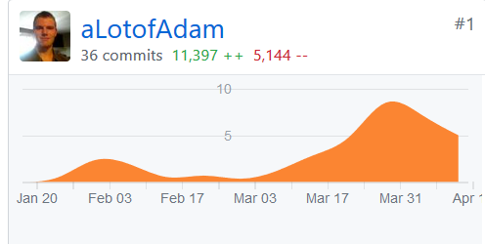
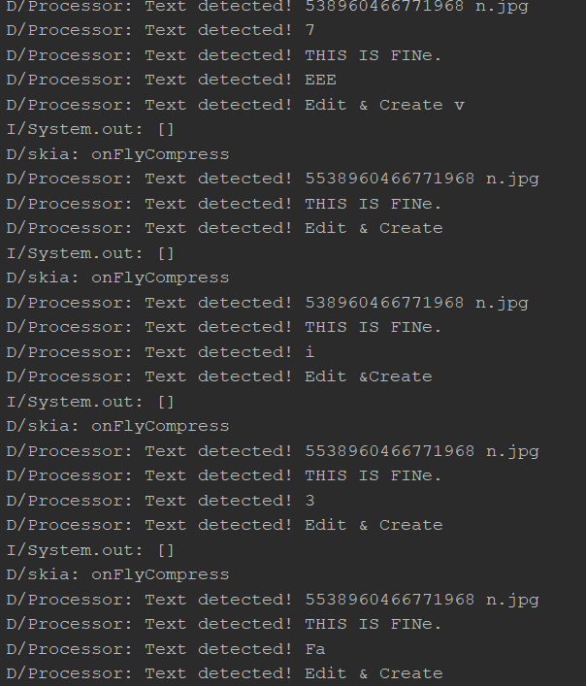
Google Vision and Grocery List

Slide 3

Recipe Subsystem
Goal of SubSystem
Get recipes (web scraper) and store them
Search, Show and display recipes information

Slide 4
Recipe Subsystem Technology
Languages: Python(web scraper), SQL, and Java
Frameworks: Android Studio and SQLite

Slide 5
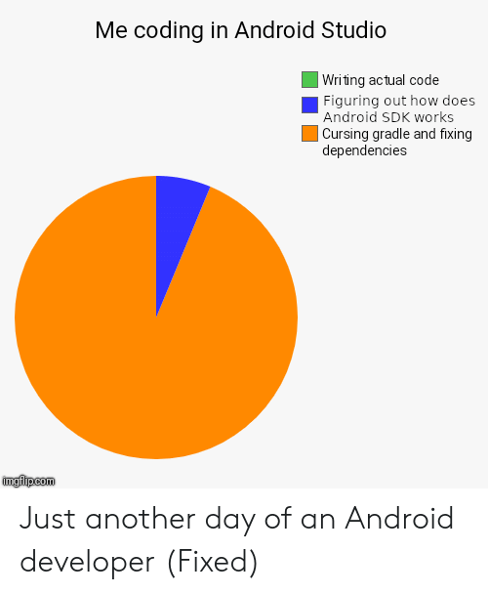
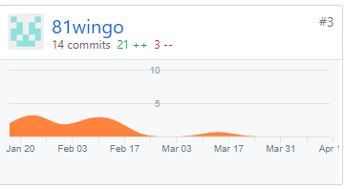
Recipe Subsystem Next Steps
Get the pictures to show(couldn't get this to work properly)
Integrate all of the code together with other subsystems, it isn't fully functional with other subsystems

Slide 6
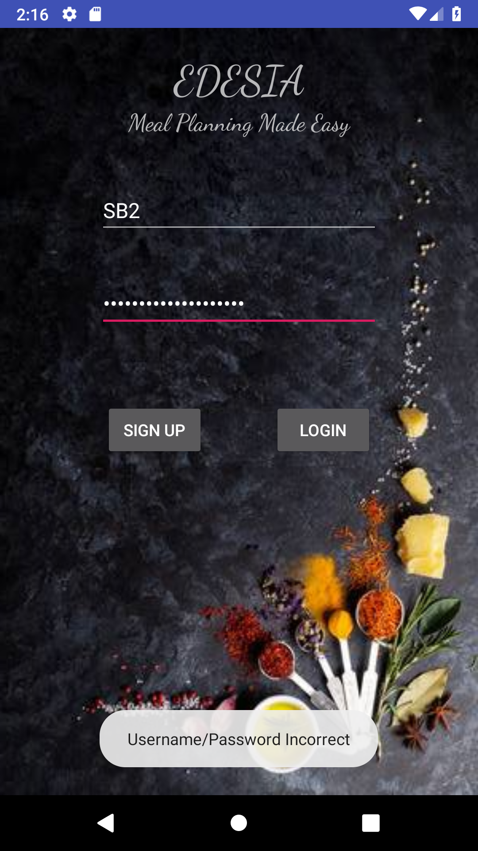
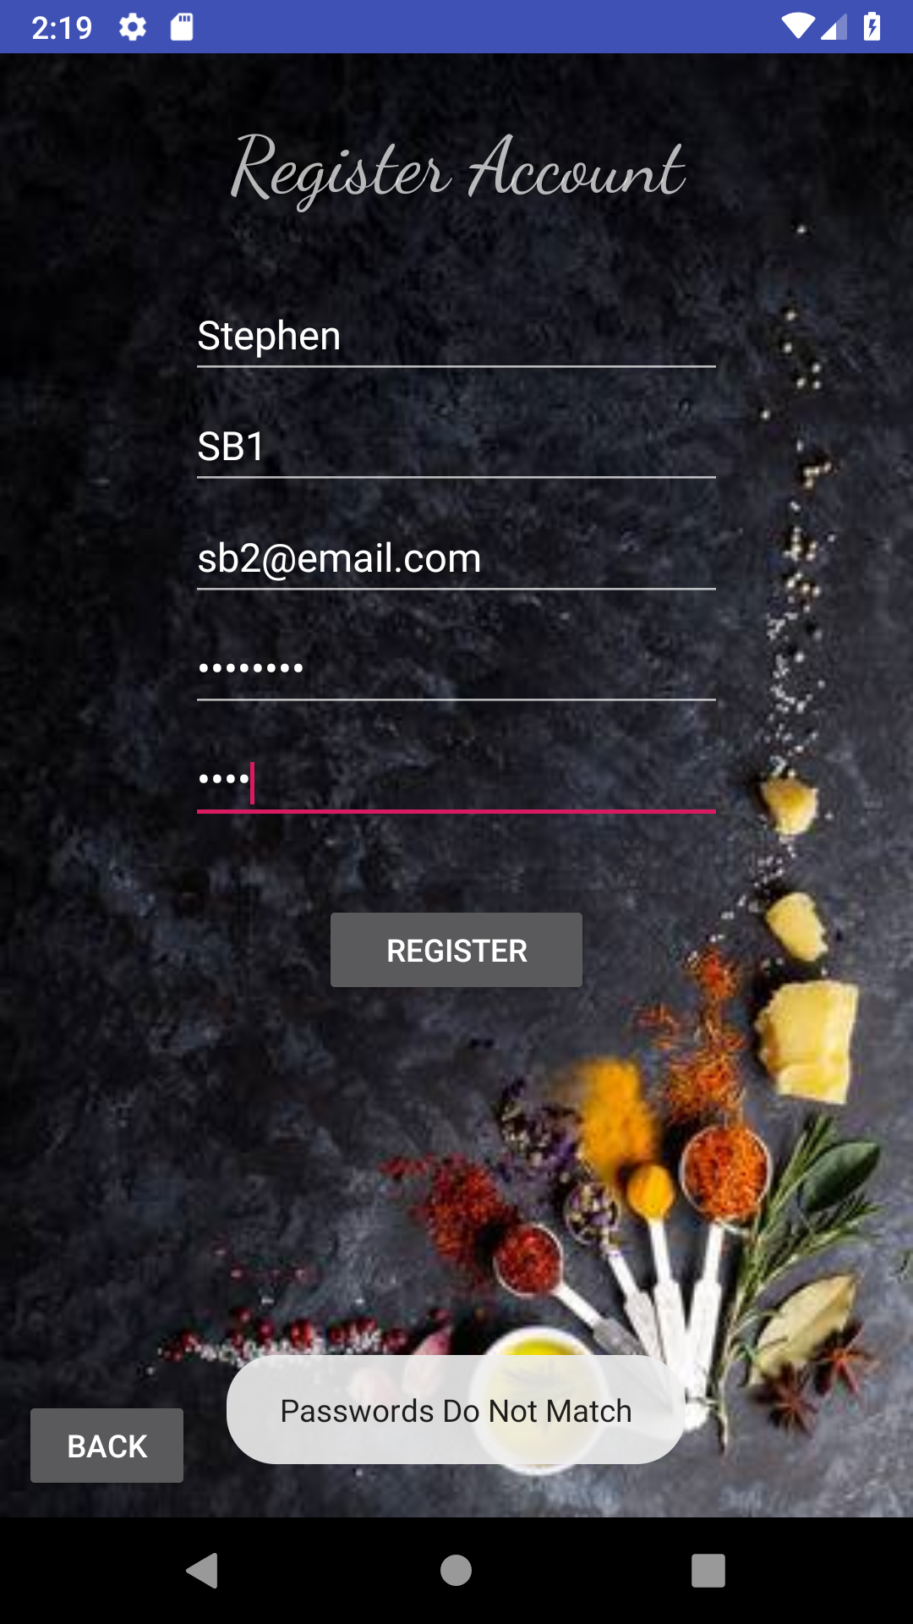

User Database
-Screenshots of error checking on user login and account registration.

Slide 7
User Login/Signup
User subsystem handles user login and sign up. User database contains all user information as well as planned recipes and favorite recipes.
Error checks are in place
Multiple tables have been added for planned meals and favorite recipes.

Slide 8
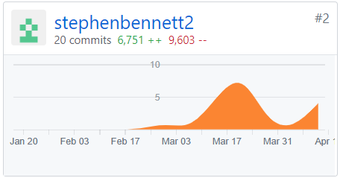
User Subsystem
-All coding across project was done in Android Studio.
Languages include Java, and XML.
SQLite was implemented for User database functionality and was accessed through Android Studio build in functions.
-Next steps: Finishing documentation, and finalizing incorporation with entire system.

Slide 9
Calendar Subsystems Demo
Meal Planning is functional.
Randomizer is functional.
Navigation is mostly complete.

Slide 10
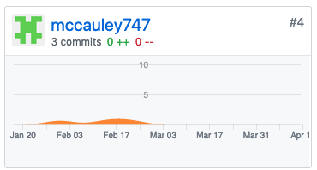
Calendar Subsystems
Goal - To allow the user to plan meals for specific days and to have the option to get random recipes for a day.
Technologies used - Java, XML, SQLite, Android specific functions.
Status - Finishing connecting subsystem to Recipe subsystem, finishing navigation between all subsystems.
Github Code Repository - Glitched.

